Slide 1

Speaker Info
Please use the intro slide
Call out and thank the sponsors on slide 2 by name
Use of the 2 speaker profile pages
Encourage the use of the #Hashtag #ScottishSummit2021 on all social media
Use the thank you slide and make sure to tell everyone that your session will be uploaded to YouTube after 14 days
Try and use as a many of the slide templates as you can as these have been made for accessibility and can be helpful to people who may require additional assistance.
Use the Accessibility checker on your slide deck Improve accessibility with the Accessibility Checker - Office Support (microsoft.com)
Upload your slide deck to the app after your session is complete.

Slide 2


#ScottishSummit2021
Nathan Clouse
D365FO, Git and ALM: how to deliver more, faster
Latheron, 12:00GMT

Slide 3






Our Sponsors

Slide 4

enVista Corp.
Technical Architect
Nathan Clouse
Microsoft MVP
I write code. Sometimes it’s good.
www.atomicax.com
@NathanClouseAX
nclouse@envistacorp.com
Notes:
Tenth doctor – David Tennant

Slide 5

Agenda
What is Source Control
TFVC
GIT
Converting To Git
Getting Started
Branching
Merging
Automation and Actions
Pull Requests
Build and Release

Slide 6

What is
Source Control
Tracks and Manages code
For F&O…
TFVC – Team Foundation Version Control
Git
GitHub
Azure DevOps
GitLab
Notes:
David Tennant – 10th doctor

Slide 7

What Should
It do
Manage
Plan
Create
Verify
Package
Secure
Release
Configure
Monitor
Protect

Slide 8

TFVC
Sucks
But it’s supported
Push based
Branches last nearly forever
Monolithic

Slide 9

Git
Is awesome
Not Supported
Modern
Pull based
Branches are short lived

Slide 10
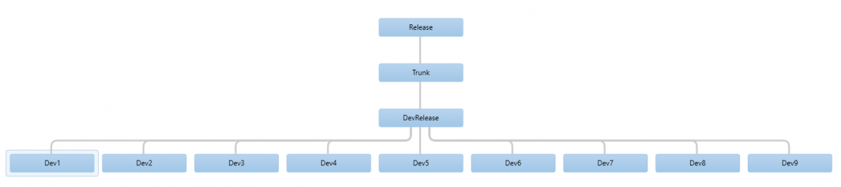
AX 2012

Slide 11
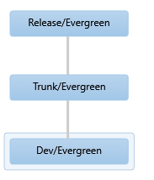
D365 F&O

Slide 12
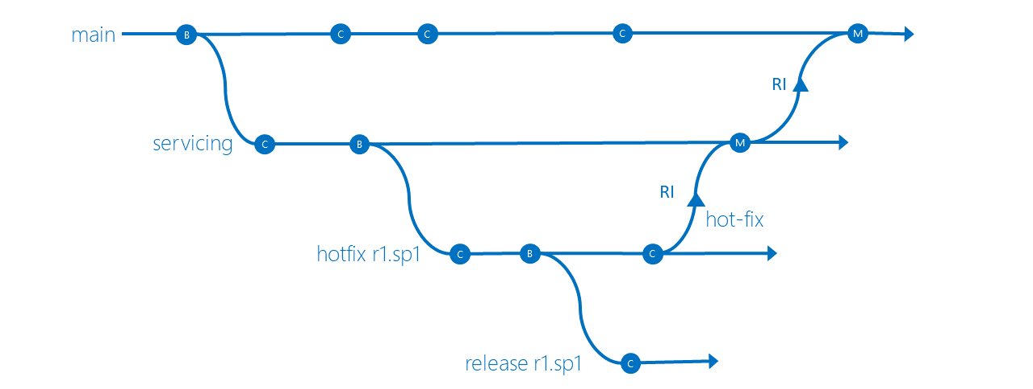
TFVC Conceptual

Slide 13
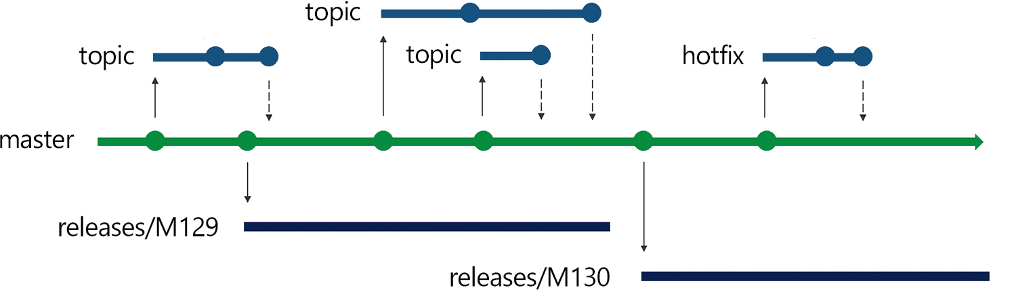
Git Conceptual

Slide 14

TFVC isn’t
All Bad
TFVC Isn’t all bad
Shelvesets
Gated Check-ins
Policies

Slide 15

Git Also
Has good things
Projects
Need to relocate
Work Offline
Branching
Per work item
Reviews
Pull Requests

Slide 16

Why is
Git Better?
Modern
Matches how things work in the real world
More “agile”
Meet requirements, 1 at a time
More Tools, More automation, More Actions

Slide 17

Converting
To Git
New Git Repo
New Branch
Move in code
Add .gitignore file
Relocate VS Projects
Clean-up

Slide 18

Converting
To Git
Change in how you think
How you work
We’re pulling together, not pushing alone

Slide 19
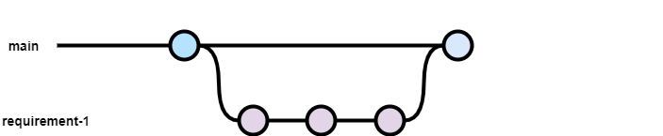
Example Branch and Pull Request

Slide 20

What is a
Pull Request
Pull requests let you tell others about changes you've pushed to a branch in a repository. Once a pull request is opened, you can discuss and review the potential changes with collaborators and add follow-up commits before your changes are merged into the base branch.
Notes:
Interested parties review
Accept
Reject
Request changes

Slide 21

When to create a
Pull Request
When development is done
AND TESTED

Slide 22

How To Create a
Pull Request
In Visual Studio
In Azure DevOps
GitHub
GitLab
etc

Slide 23
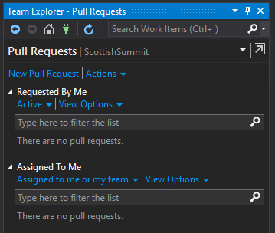
New Pull Request

Slide 24
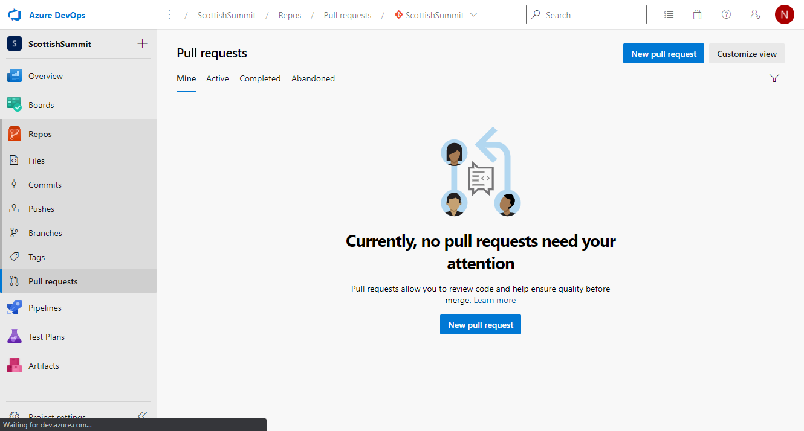
New Pull Request

Slide 25
Automation
And Actions
Build a pull request before review
Checks for Pull Requests
Automated testing for Pull Requests (Advanced)
Automated Build for Commits

Slide 26
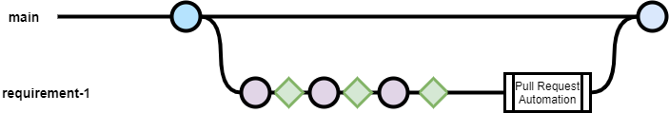
Extend Branch and Pull Request

Slide 27
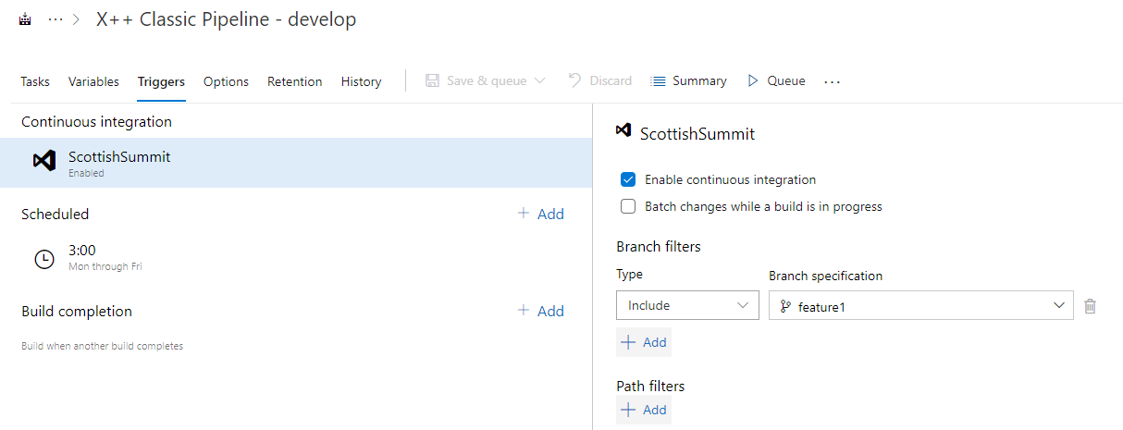
Continuous Integration
Notes:
Automate build and test of code
For developers
Better integrates teams and code
Bugs are caught earlier

Slide 28
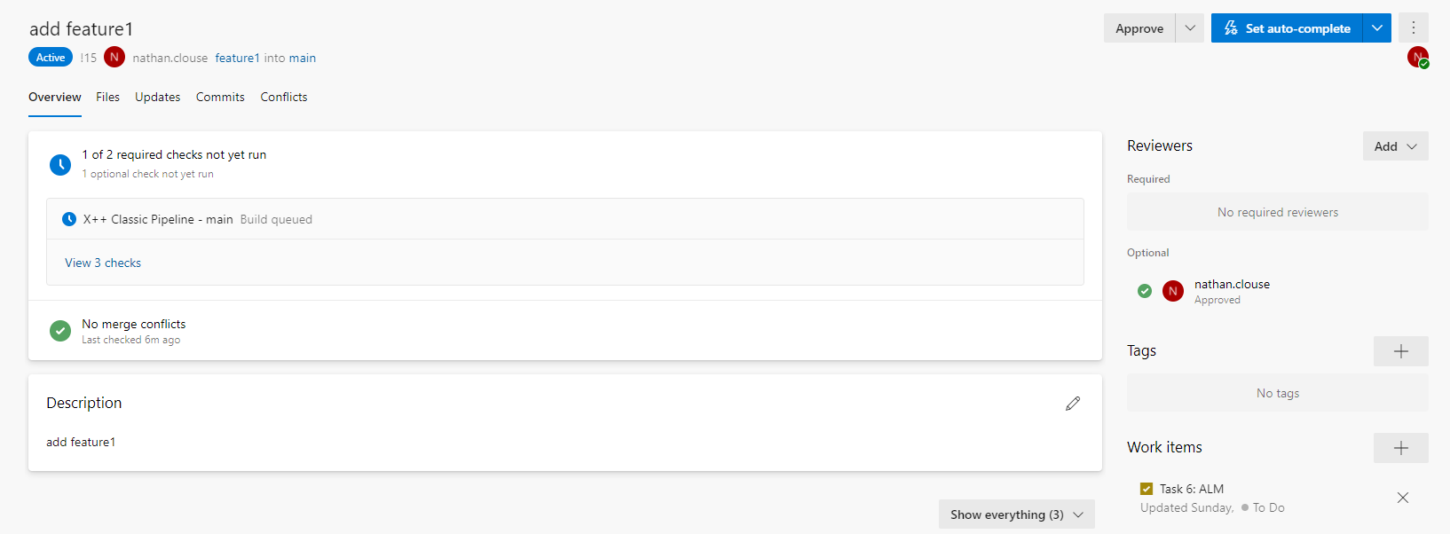
Pull Request Example

Slide 29
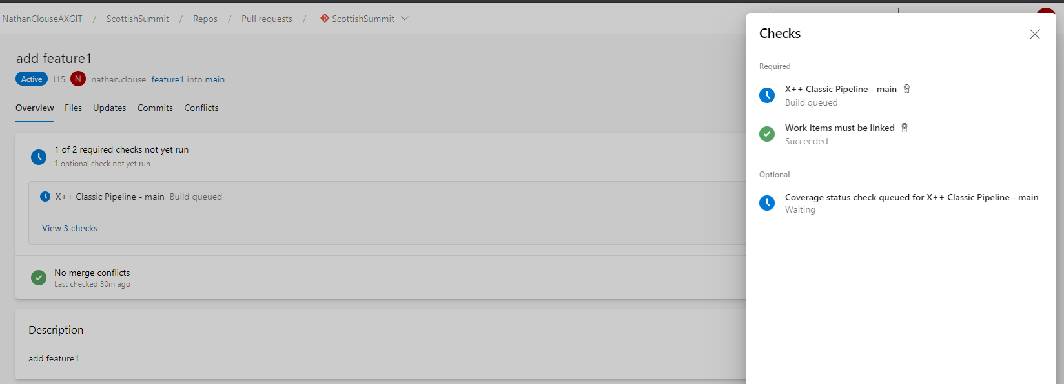
Pull Request Checks

Slide 30
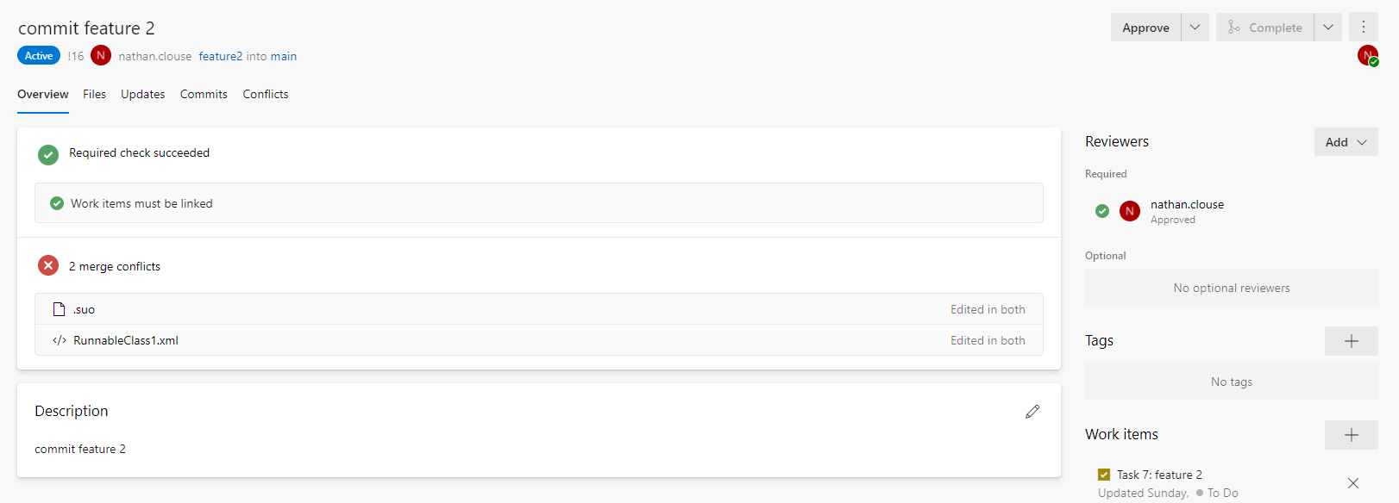
Example Pull Request with Merge Conflicts

Slide 31
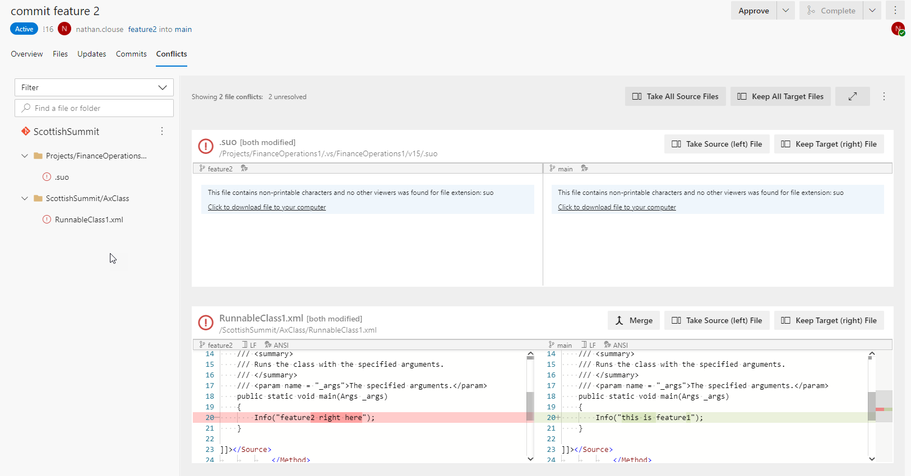
Merge Conflicts

Slide 32
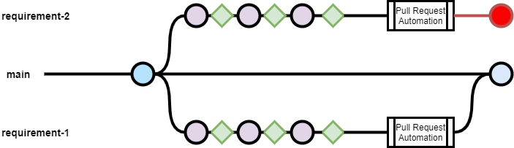
Combined branch and Pull requests Example

Slide 33
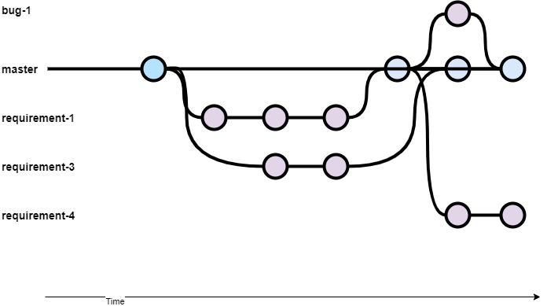
Branch and Resource Management

Slide 34
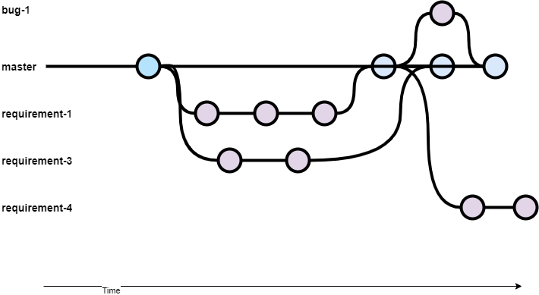
Branch and Commit Management

Slide 35
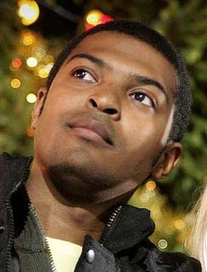


Build and Test
Templates
2019 Creative Templats
SysTest
Automatic discovery
Built into build template*
ATL (Acceptance Test Library)
Consistent
Discoverable
Performance

Slide 36
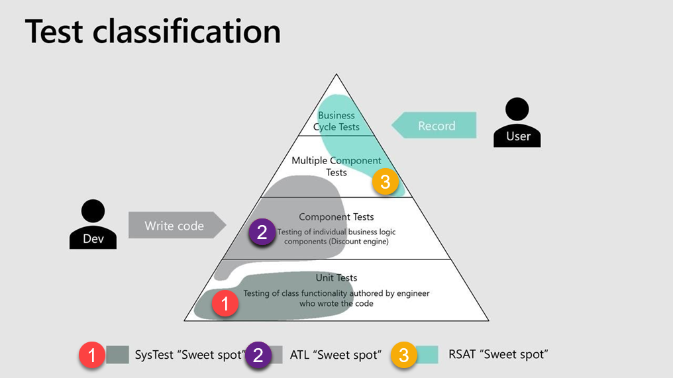

Slide 37
Release
Release to LCS
Release to UAT

Slide 38
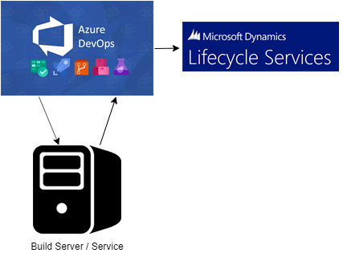
To LCS
Stores result in LCS for your build in your asset library
Easy to select from
No fuss

Slide 39
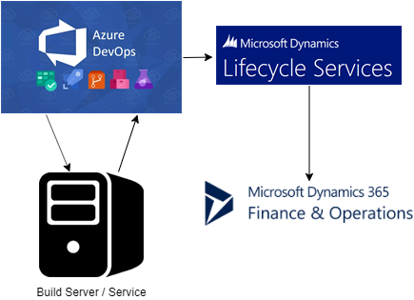
To an Environment (UAT)
Automatic deployment to a standard environment

Slide 40
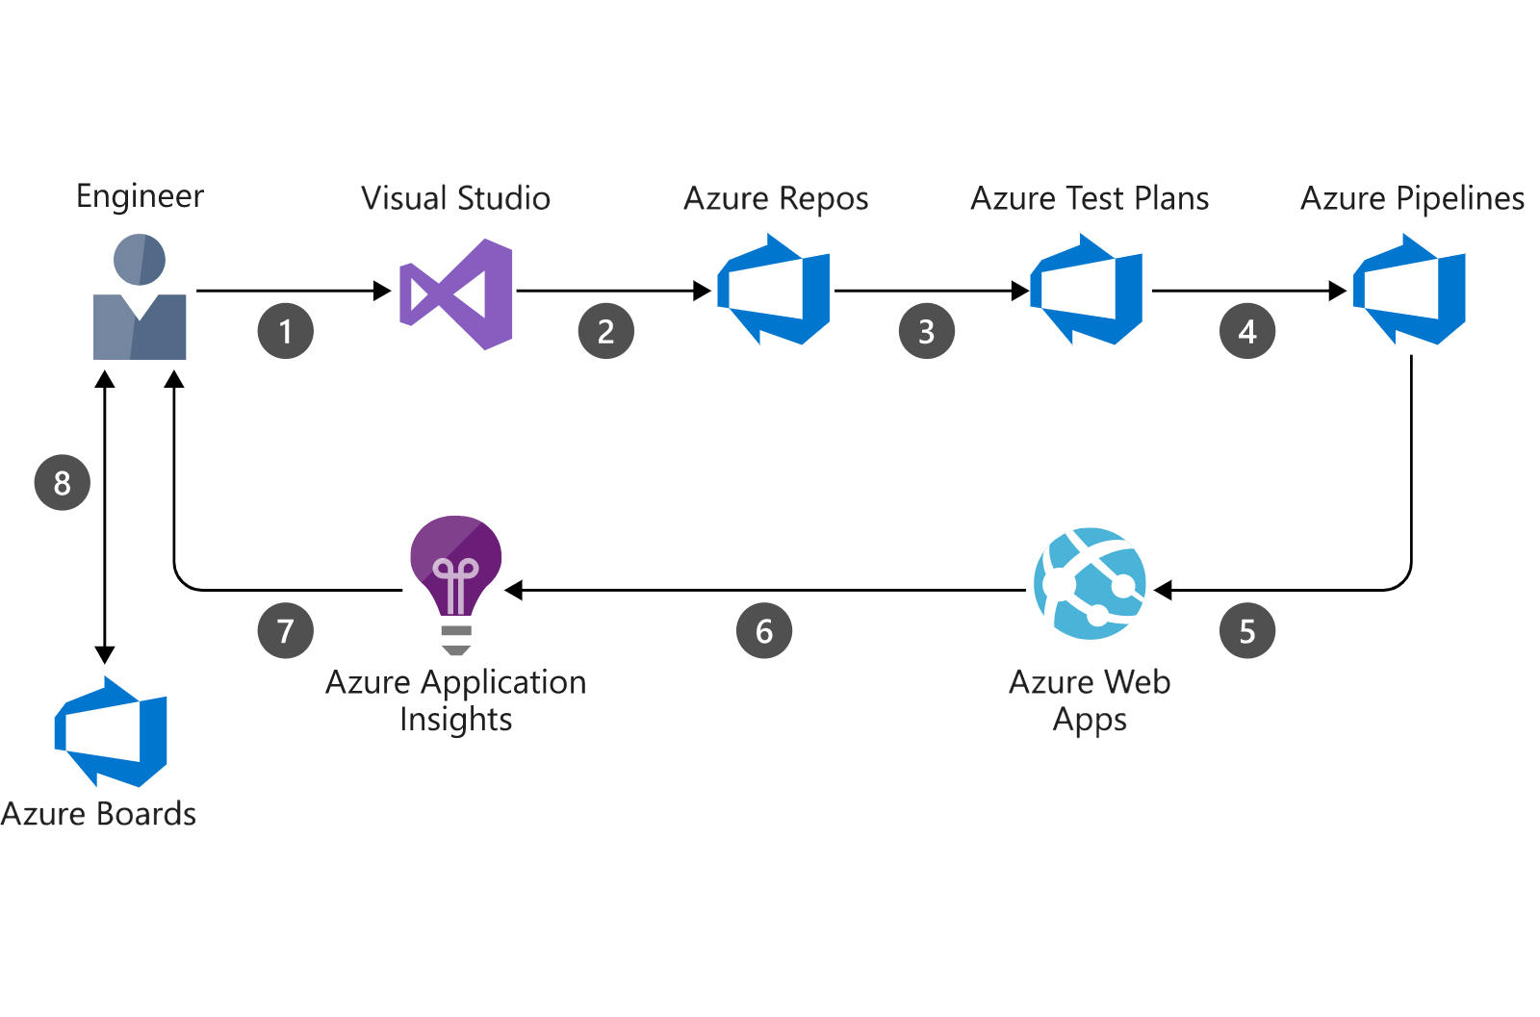
New Feedback Loop

Slide 41
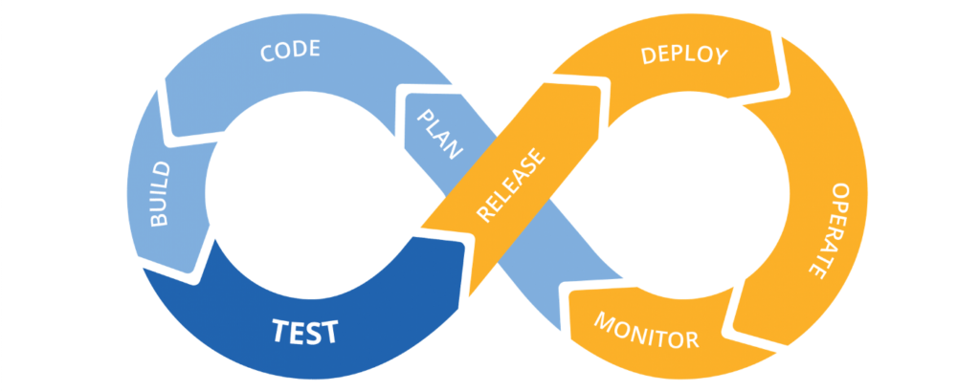

Slide 42
Sources
http://www.atomicax.com/article/giting-started-git-d365fo-and-other-puns
http://www.atomicax.com/article/getting-started-gated-checkins
http://www.atomicax.com/article/moving-tfvc-git-azdo
http://www.atomicax.com/article/getting-started-tfvc-and-d365fo
http://www.atomicax.com/article/why-gated-check-ins-are-awesome
http://www.atomicax.com/article/staging-and-git

Slide 43
Thank You
#ScottishSummit2021

